Slide 1
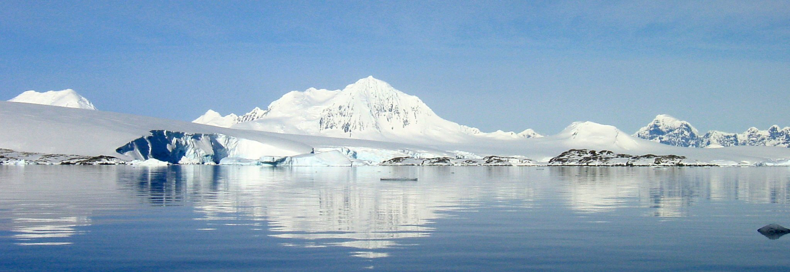
What is life like in the Polar Regions?
Homework
Name:

Slide 2
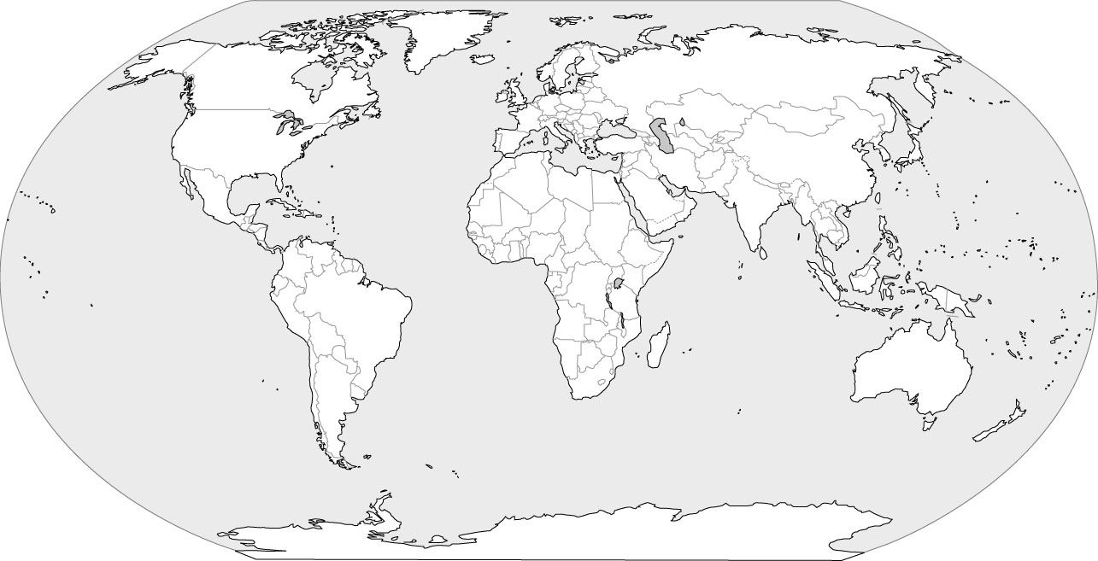
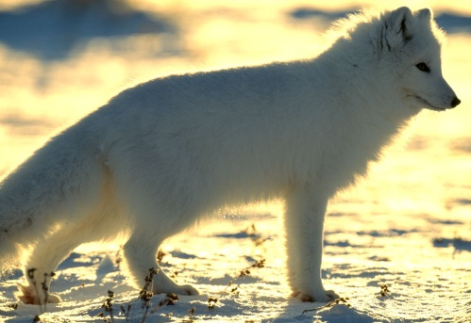
Antarctica and the Arctic: The Environment
Colour in Antarctica and the Arctic on this map.
Write down as many words as you can think of to describe the weather in these places:
One of these places is in the Northern Hemisphere, the other is in the Southern Hemisphere. Write down where you think each place is found:
ANTARCTICA:
ARCTIC:

Slide 3
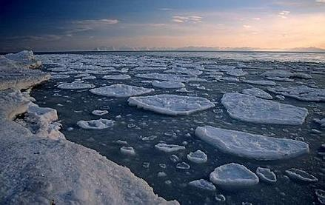
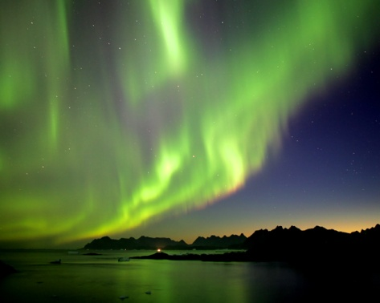
Antarctica and the Arctic: The Environment
What is the BIG difference between Antarctica and the Arctic?
What is the difference between Winter and Summer in the poles?
Use the words found on these sheets to fill in the word search. There are 7.
M | F | A | V | V | N | G | Z | X | X
F | L | C | Q | Y | R | J | A | V | W
R | A | I | S | A | Y | N | D | P | N
E | I | T | G | D | R | T | N | S | G
E | X | C | A | C | D | C | W | N | R
Z | Q | R | E | D | Z | R | T | Q | J
I | K | A | C | P | L | Y | J | I | W
N | L | T | Z | D | R | O | G | J | C
G | U | N | U | M | S | G | C | H | T
M | V | A | F | H | I | J | X | J | U
What is in this picture?

Slide 4
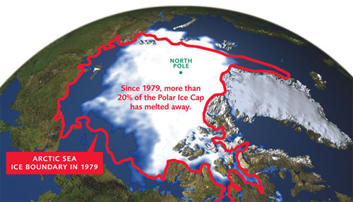
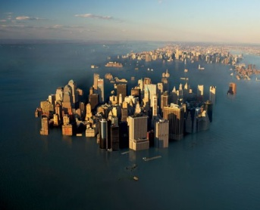
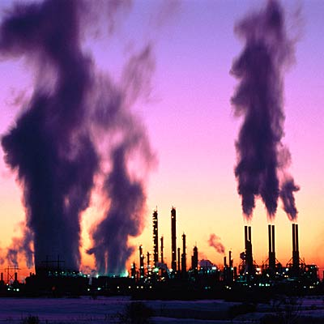
Antarctica and the Arctic: The Effects of Humans
What effect COULD global warming have?
What things cause global warming?

Slide 5
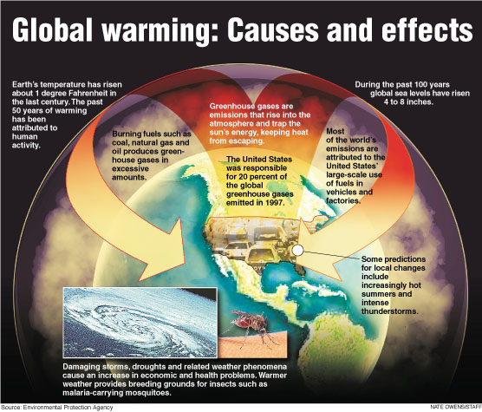
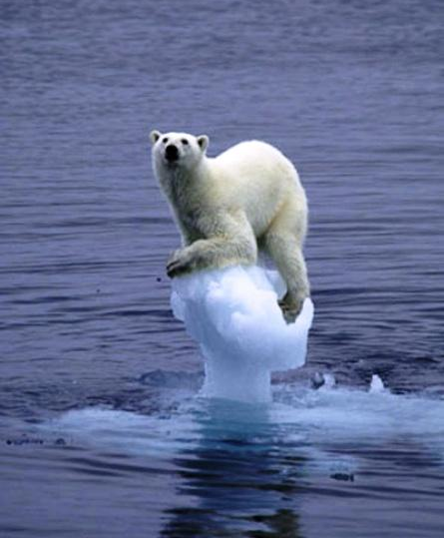
Antarctica and the Arctic: The Effects of Humans
What effect does Global warming have on the animals around the ice caps?

Slide 6
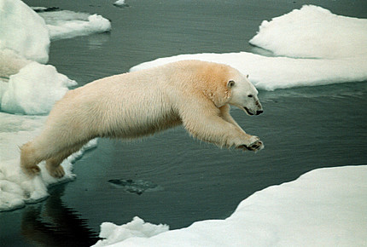
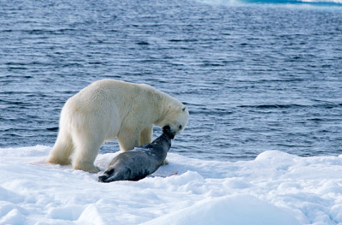
Antarctica and the Arctic: The Polar Bear
What things about the Polar Bear make it suited to living in the cold?
What sort of things does a Polar Bear eat?
Which part of the seal does the Polar Bear like best?

Slide 7
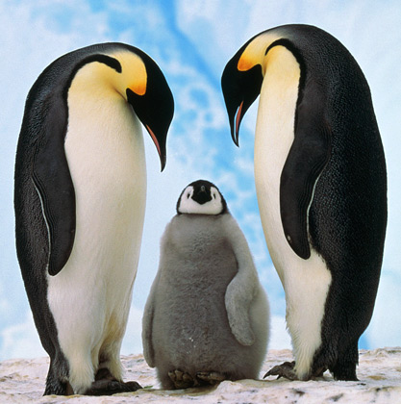
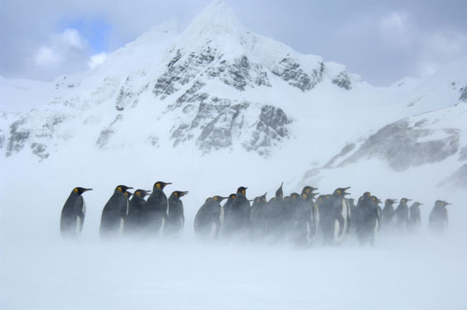
Antarctica and the Arctic: The Penguin
What type of penguin is this?
What sort of things does this type of penguin eat?
Why are these penguins huddled together?
How do the penguins feed their young?

