Slide 1
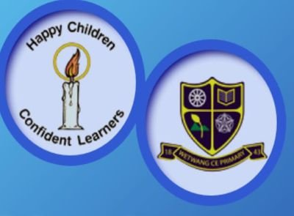
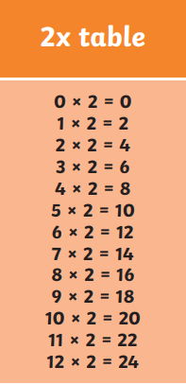
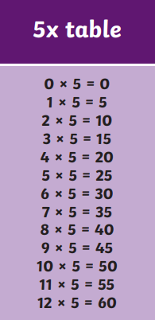
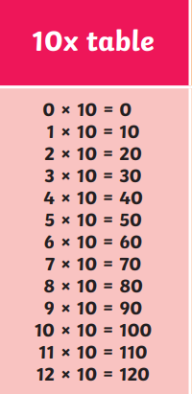
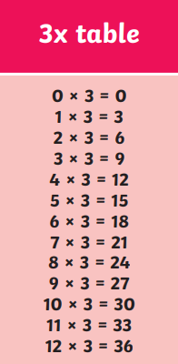
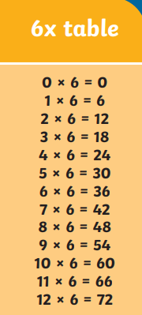
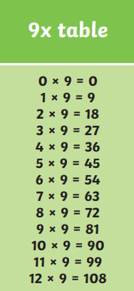
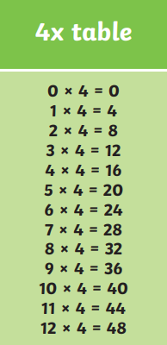
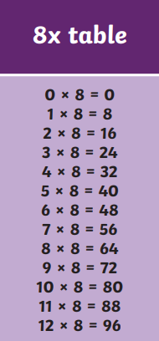
Key Vocabulary
What is 2 multiplied by 7?
What is 5 times 6?
What is 80 divided by 10?
What is 40 shared by 5?
What are 2 lots of 9?
KEY INSTANT RECALL FACTS
SUMMER TERM 2 YEAR 3
Revision of the times tables from year 2 and 3
By the end of the half-term, your child should be able to instantly recall these facts. We will be working on these facts in school, but because little and often is essential for instant recall, it would help if they could practise at home.
Times Table Rockstars - Your child should have a Times Table Rockstars Login and it should be set to the times table that your child is learning. Spending 10 minutes, 3 x a week will really help to support the learning of times tables.
Songs and Chants – You can buy Times Tables CDs or find multiplication songs and chants online. If your child creates their own song, this can make the times tables even more memorable.

